Slide 1


FIN在市场上的比较
开放性 | FIN | 其他
直观和移动端友好的用户体验
我们不会将您锁定在专有系统中
现有自动化系统的标准用户界面
原生支持Haystack 4
简化多系统的集成
基于浏览器的组态和调试
优化了数据分析的快速数据库
强大的数据库查询语言
易使用 | FIN | 其他
上下文相关，方便的导航栏 – 减少不必要的点击
自动生成的超链接 (Magic Bubbles)，减少工程时间
仪表盘生成器可以定制化UI
集成的报警控制台
语义标签模型改善了数据管理
工作流工具提高了效率
大量的向导简化了通用任务
可变尺寸的2D和3D画面
简化设备管理的模板
通过标签让画面和逻辑也复用
上下文相关的计划功能
自动生成的点画面和摘要表 – 工程零工作量
增值服务 | FIN | 其他
Edge2Cloud技术可以在任何地方方便和安全的远程访问
含标准的通讯驱动
*
有
没有
*
需要额外的编程
需要额外的费用

Slide 2
FIN & Competition
Open | FIN | Competition
Intuitive and mobile friendly user experience
We don’t lock you into a proprietary system – work with any system integrator
Standard UI over existing automation systems
Natively supports Haystack 4
Simplifies multi-system integration
Browser-based configuration and commissioning
Analytics optimized fast database
Powerful database query language
Ease of Use | FIN | Competition
Context-sensitive, predictive navigation – eliminate clicks
Auto-generated hyperlinks (Magic Bubbles) saves engineering time
Dashboard builder app for customized UIs
Integrated alarm console
Semantic tagging model to improve data management
Workflow tools to improve productivity
Extensive range of wizards to simplify common tasks
Resizable graphics in 2D and 3D
Templates to simplify device management
Reusability of graphics and logic with tagging
Scheduling functionality which is context-sensitive
Auto-generated point graphics and summary tables – zero engineering required
Value-Add Services | FIN Stack | Competition
Edge2Cloud technology for easy and secure remote access anywhere
Standard drivers included
*
Available
Not Available
Additional programming required
*
Additional cost

Slide 3
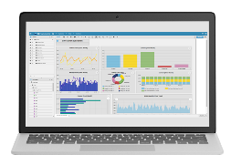
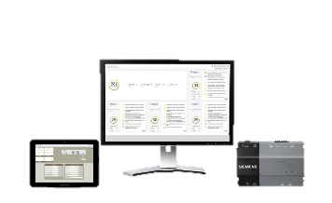

FIN Framework & Tridium N4
FIN Framework
Tridium N4
Global Programming
Function Block Application
Function Block (i.e. Wire Sheet)
Trending
Local trending, sync BACnet & Haystack
Tridium Buster
Local trending, sync BACnet & Haystack
Alarm Management
Local alarm manager, sync BACnet & Haystack
Tridium Buster
Local alarm manager, sync BACnet
Scheduling
Local scheduling, sync BACnet & Haystack
Local scheduling, sync BACnet
User Management
Custom profile based user, unlimited users
Custom profile based user, unlimited users
Weather Data
Yes, data can be applied to programming
Yes, data can be applied to programming
Advanced Reporting
Yes
Tridium Buster
Yes
Notes/Task Documentation
Yes (full reporting)
Tridium Buster
Limited
Native Tenant Billing
Yes
Tridium Buster
No
Browser Based Management
HTML5 - Full feature, any network client
Yes, limited HTML5 functionality
Remote Notification
Yes w/ Escalation
Yes w/ escalation

